Slide 1

Growth Charts
Dr. Aleksandra Jassim R4

Slide 2
Objectives
Plot measurements on WHO growth charts
Interpret growth indicators
Interpret trends

Slide 3
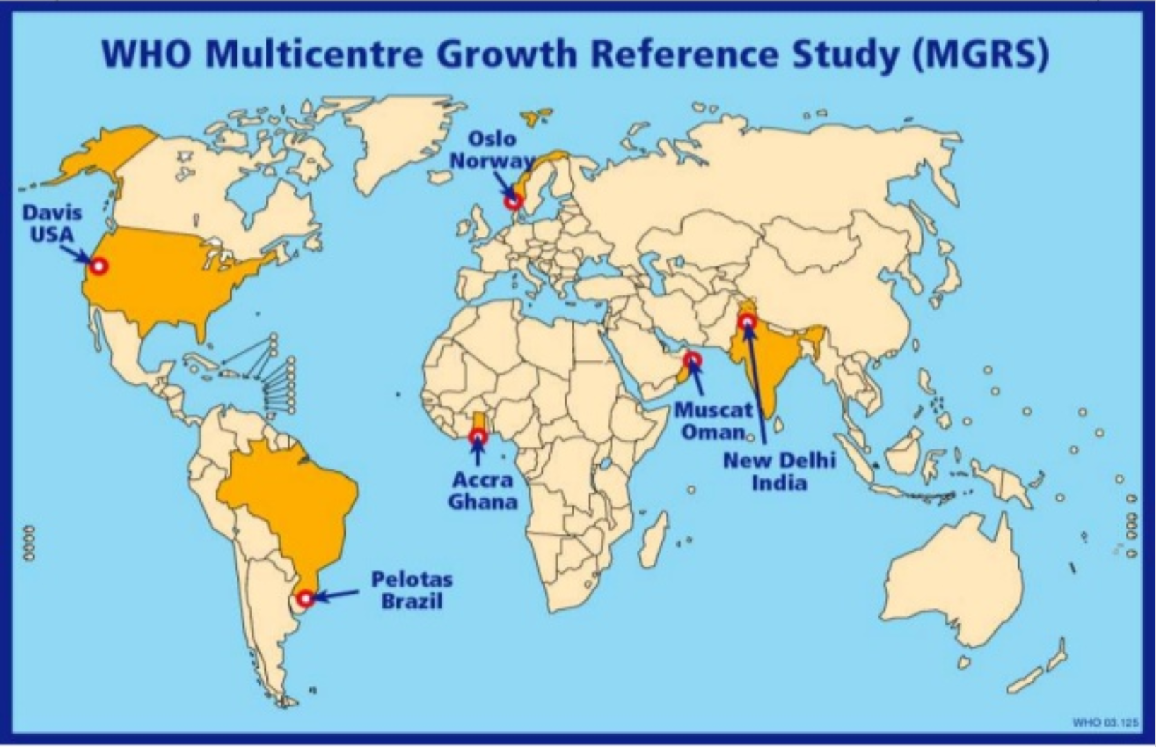
Why WHO growth charts?

Slide 4
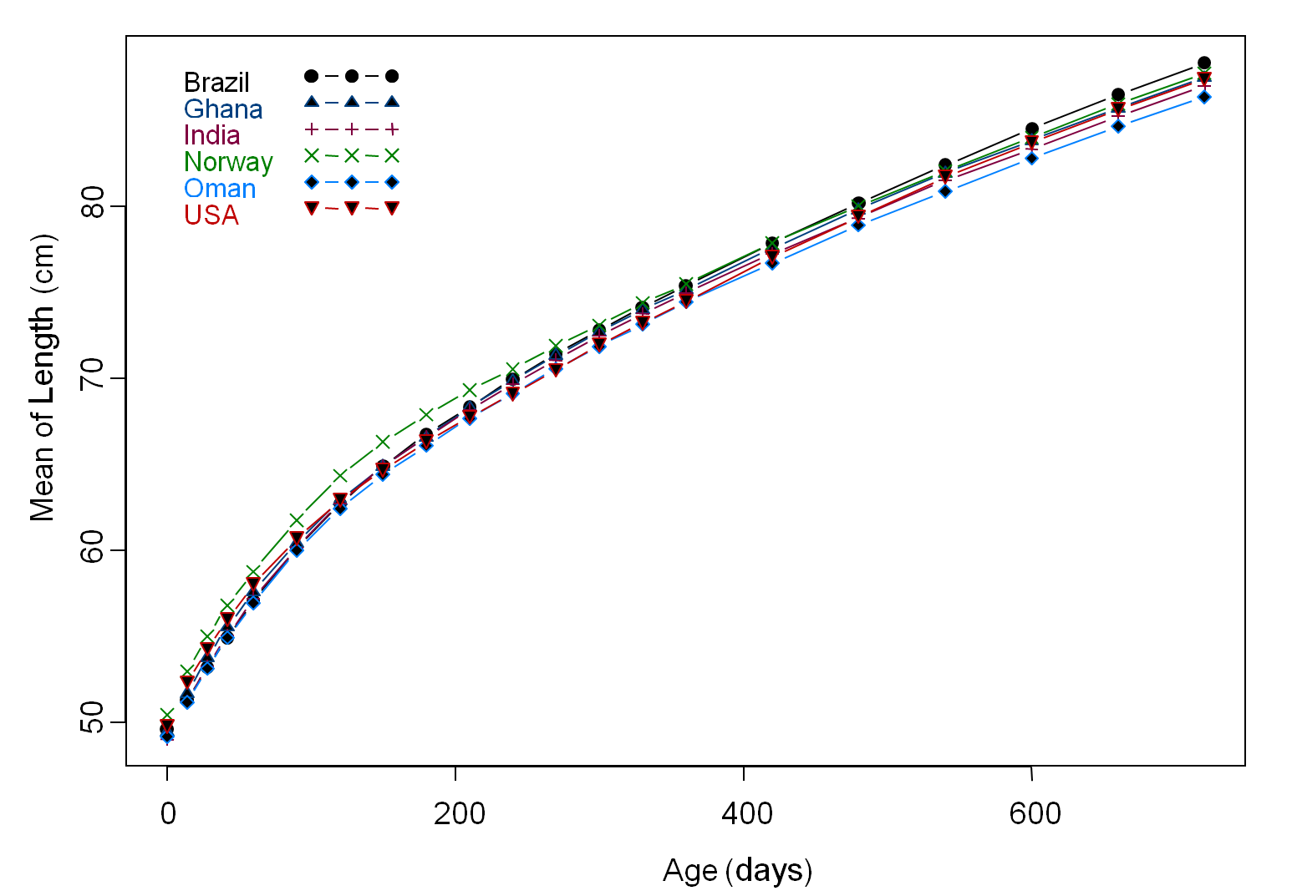
Why WHO growth charts?

Slide 5
Types of charts
Weight-for-age
Length/height-for-age
Weight-for-length/height
BMI-for-age

Slide 6
EXERCISE

Slide 7
Fatma, 6 weeks old
Weight-for-age

Slide 8
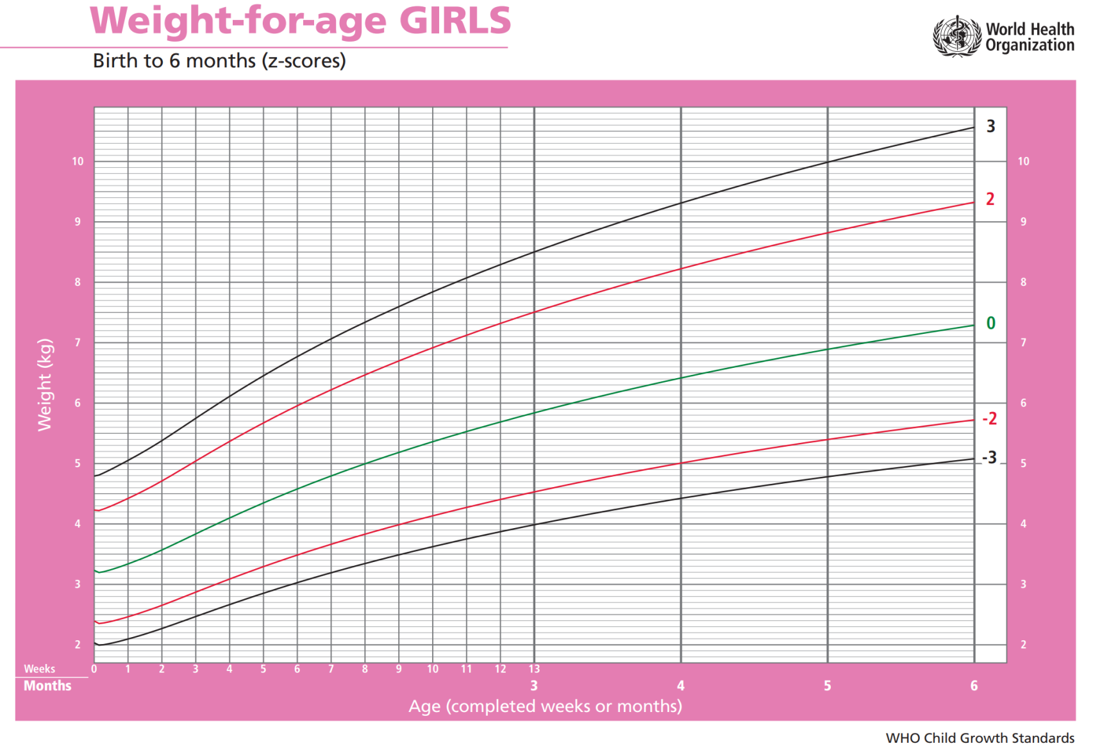
Fatma, 6 weeks old
Weight-for-age

Slide 9
Sami, 2 years 1 month
Weight-for-height

Slide 10
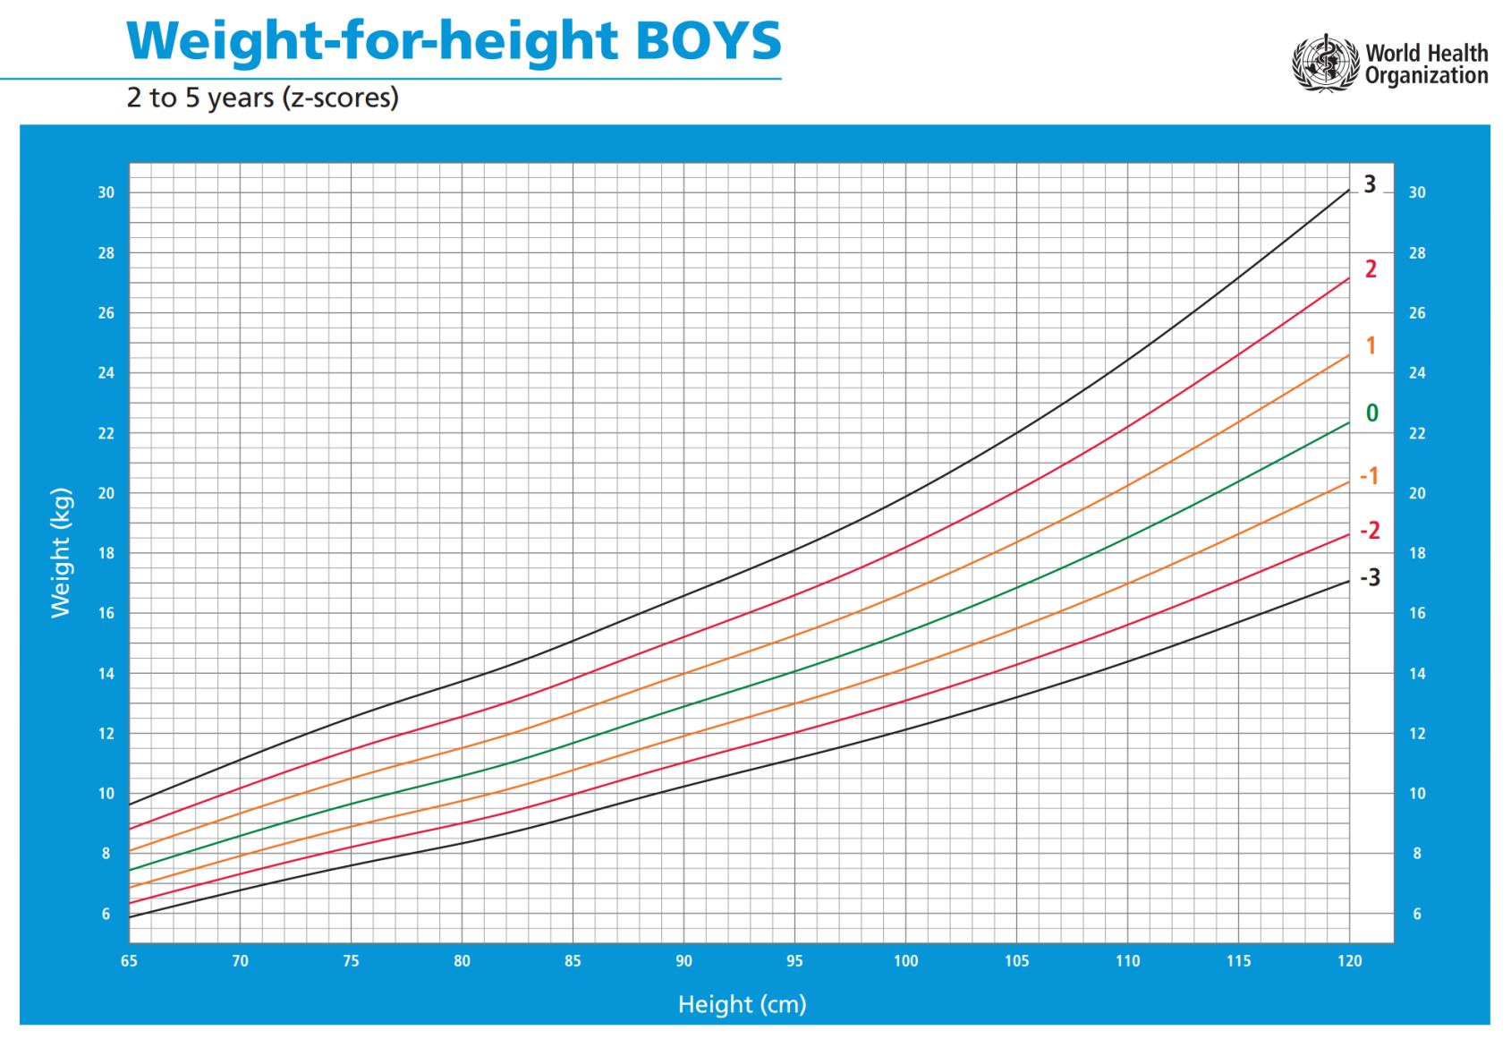
Sami, 2 years 1 month
Weight-for-height
Omar, 5 months
Length-for-age

Slide 11
Nadia, 5 months
Length-for-age

Slide 12
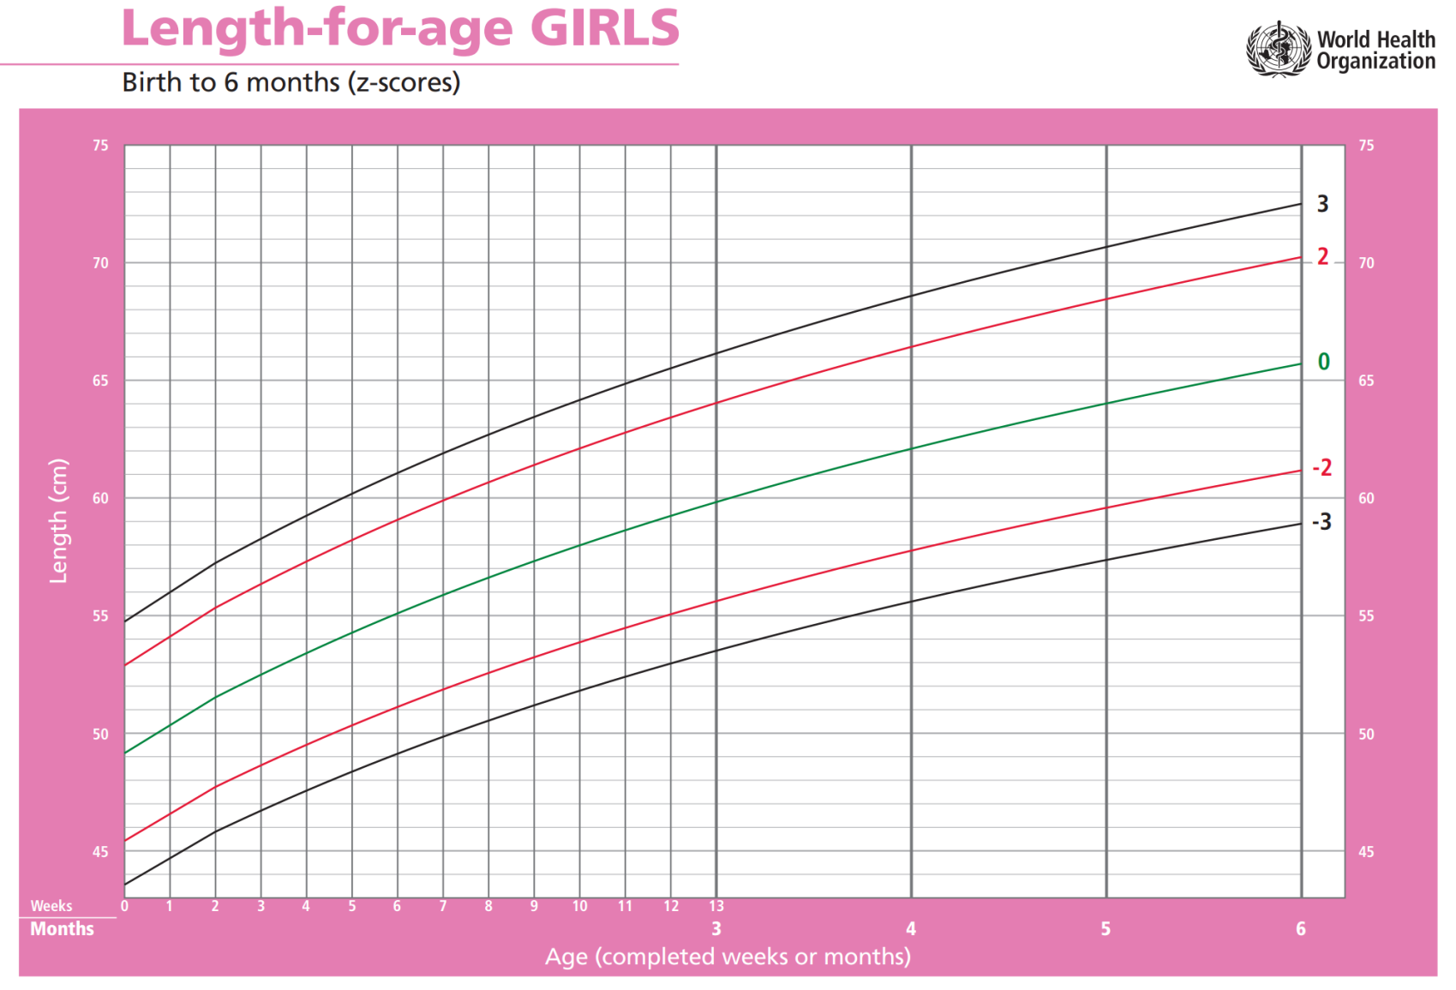
Nadia, 5 months
Length-for-age

Slide 13

Plot: Nadia, 5 months
Length 59cm

Slide 14
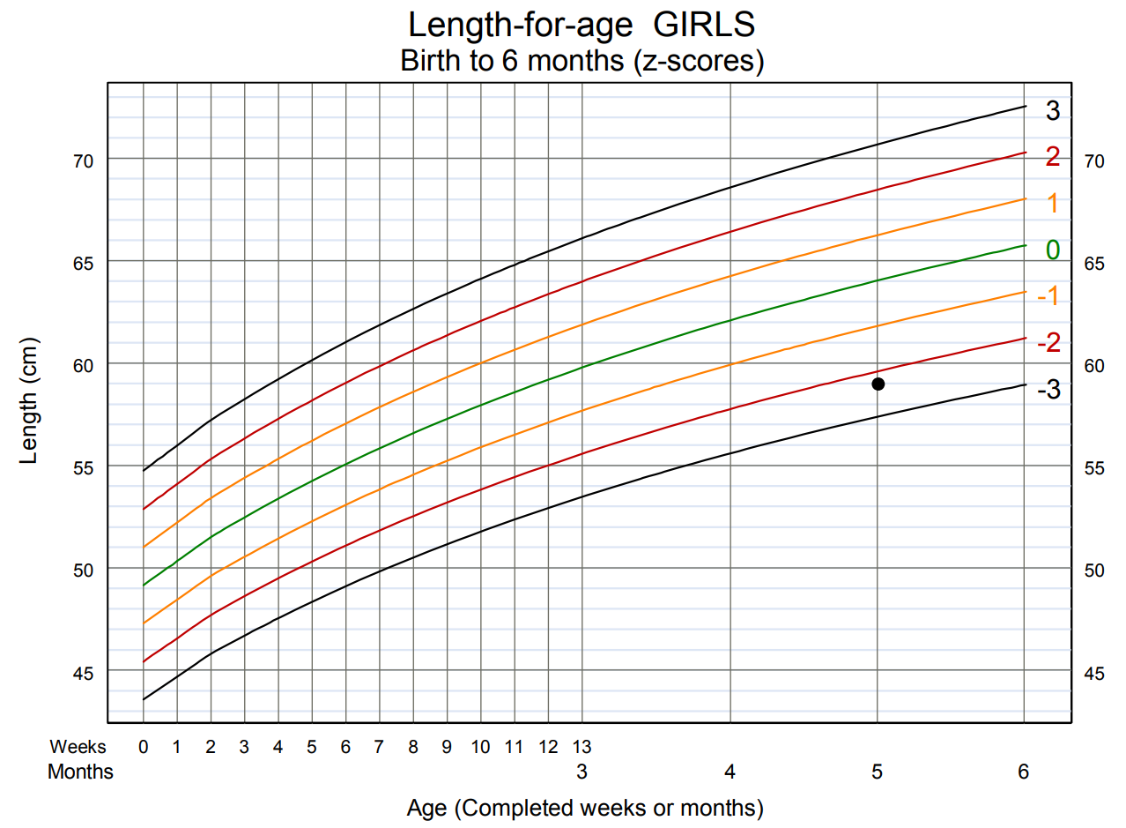
Plot: Nadia, 5 months
Length 59cm

Slide 15
Interpretation of growth indicators
Relation to median
Relation to z-score lines
Any growth problem or risk of a problem?

Slide 16
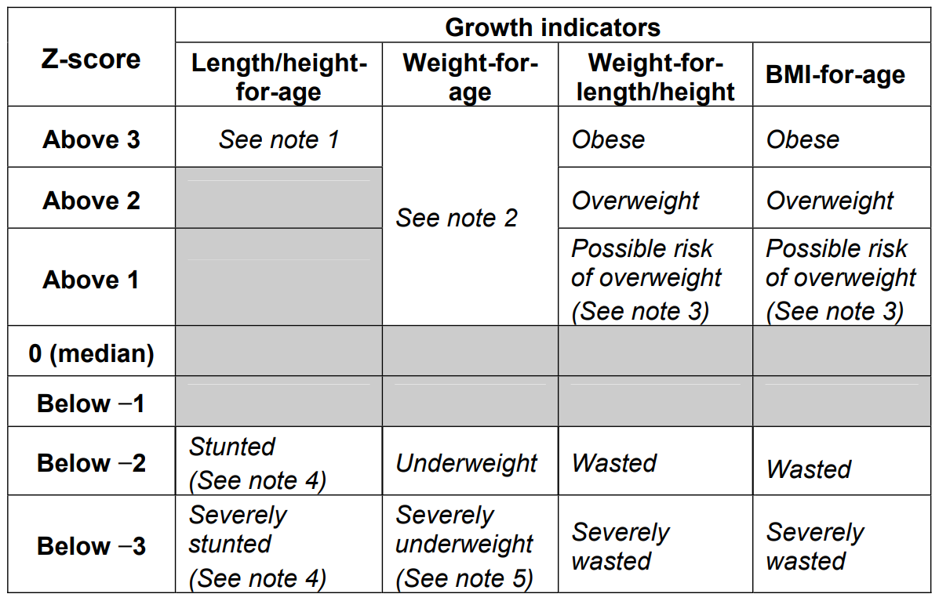
Interpretation of growth indicators

Slide 17
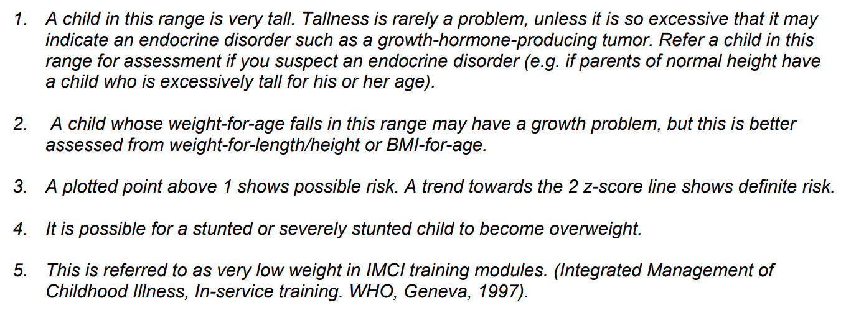
Notes:

Slide 18
Nadia
Stunted
Why?
Inadequate nutrients to support normal growth
Repeated infections

Slide 19
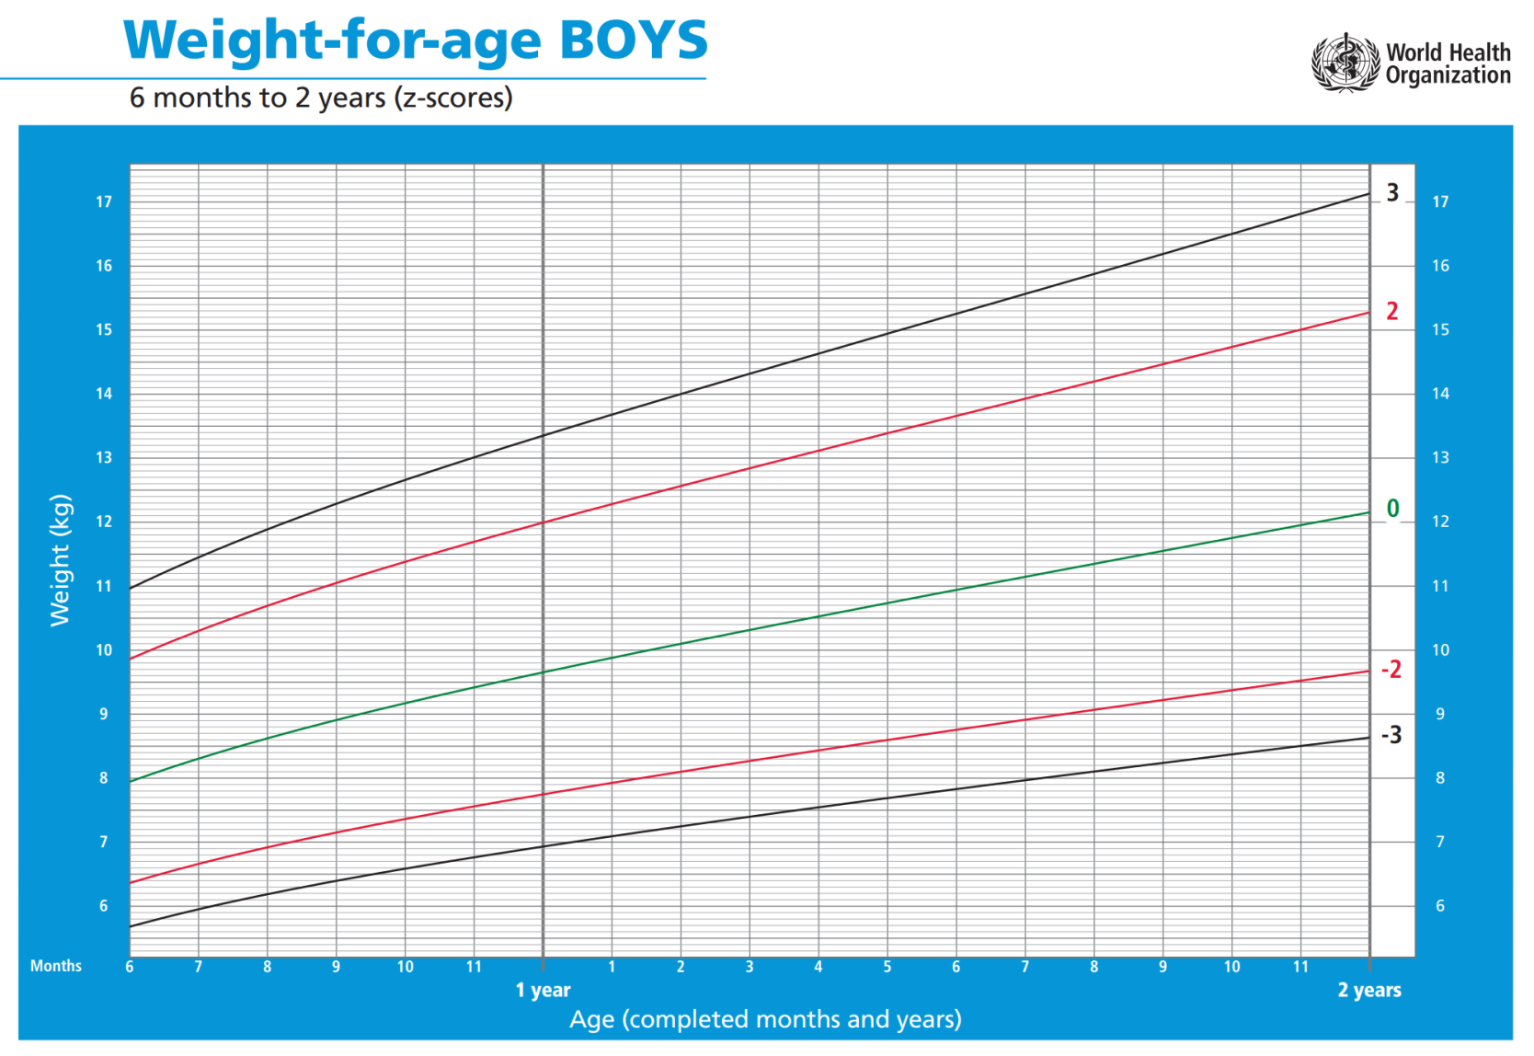
Plot: Jassim, 1 year 1 month
Weight 7,4kg

Slide 20
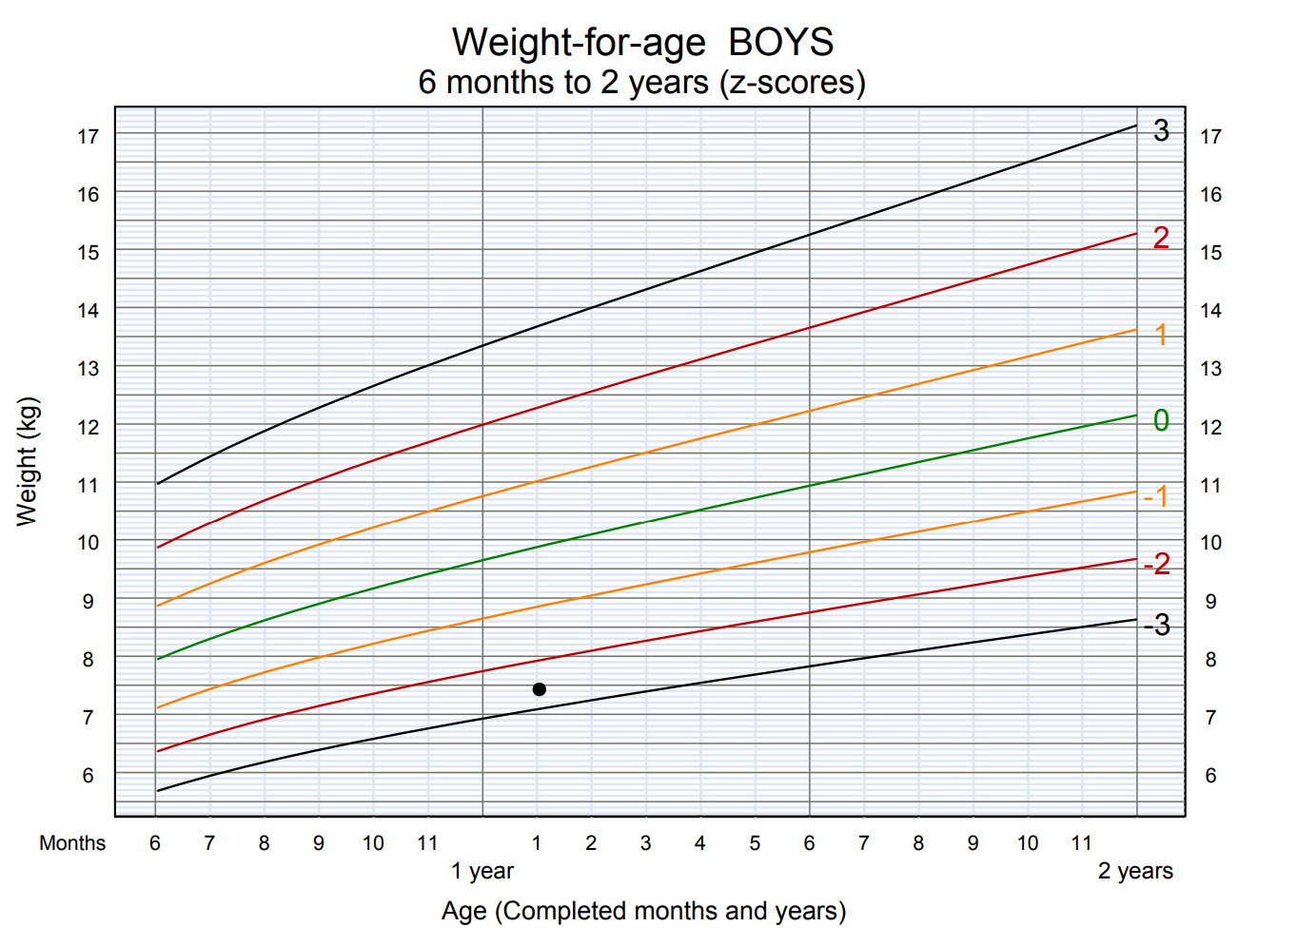
Plot: Jassim, 1 year 1 month
Weight 7,4kg

Slide 21
Interpreting growth trends
Normal trend – parallel to median
and z-score lines

Slide 22
These situations suggest a problem or risk:
Growth line crosses z-score line
Sharp incline or decline
Line remains flat ( stagnant )

Slide 23
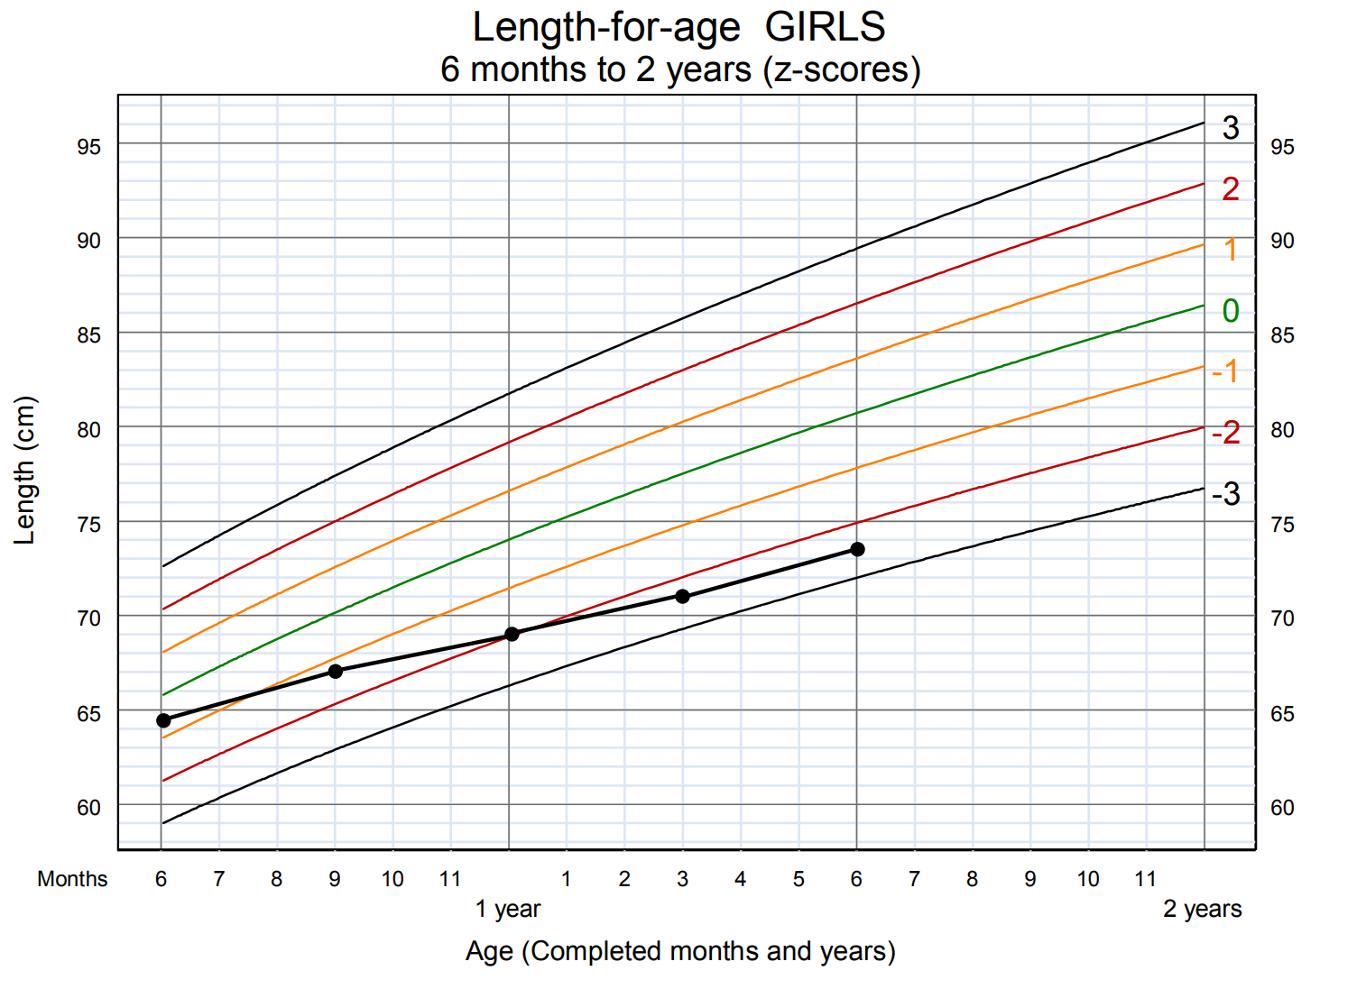
Cecile

Slide 24
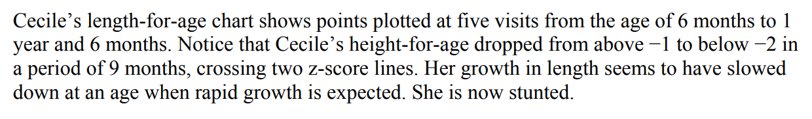

Slide 25
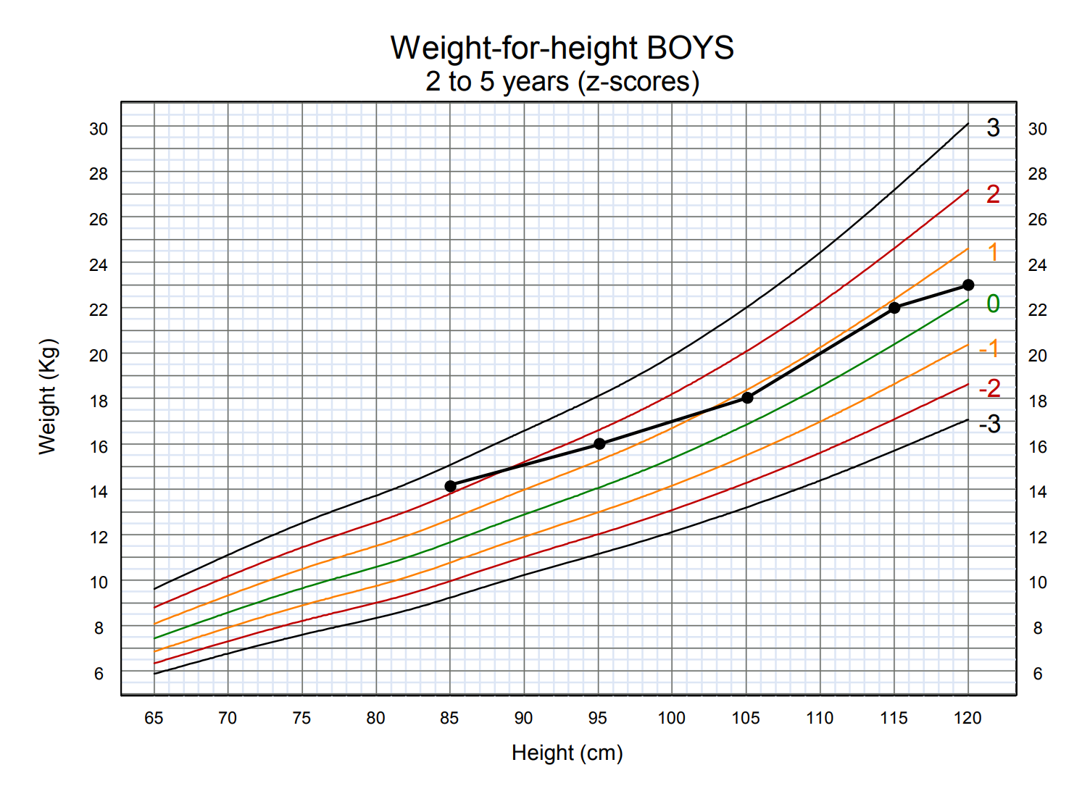
Raj

Slide 26
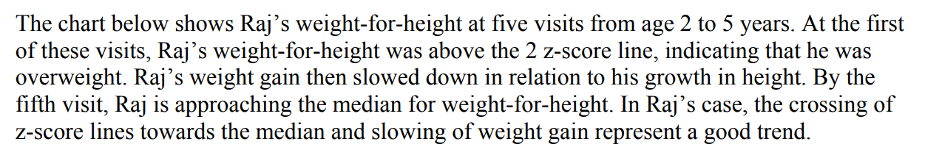

Slide 27
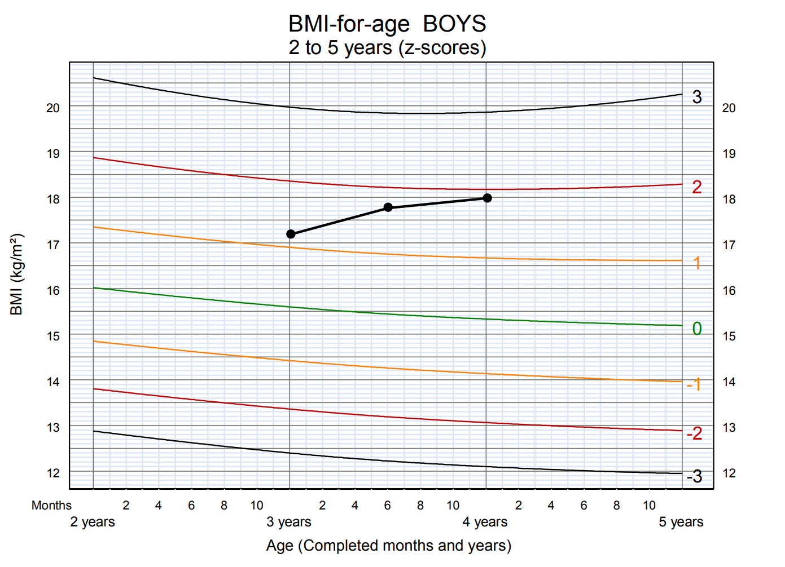
Adil

Slide 29
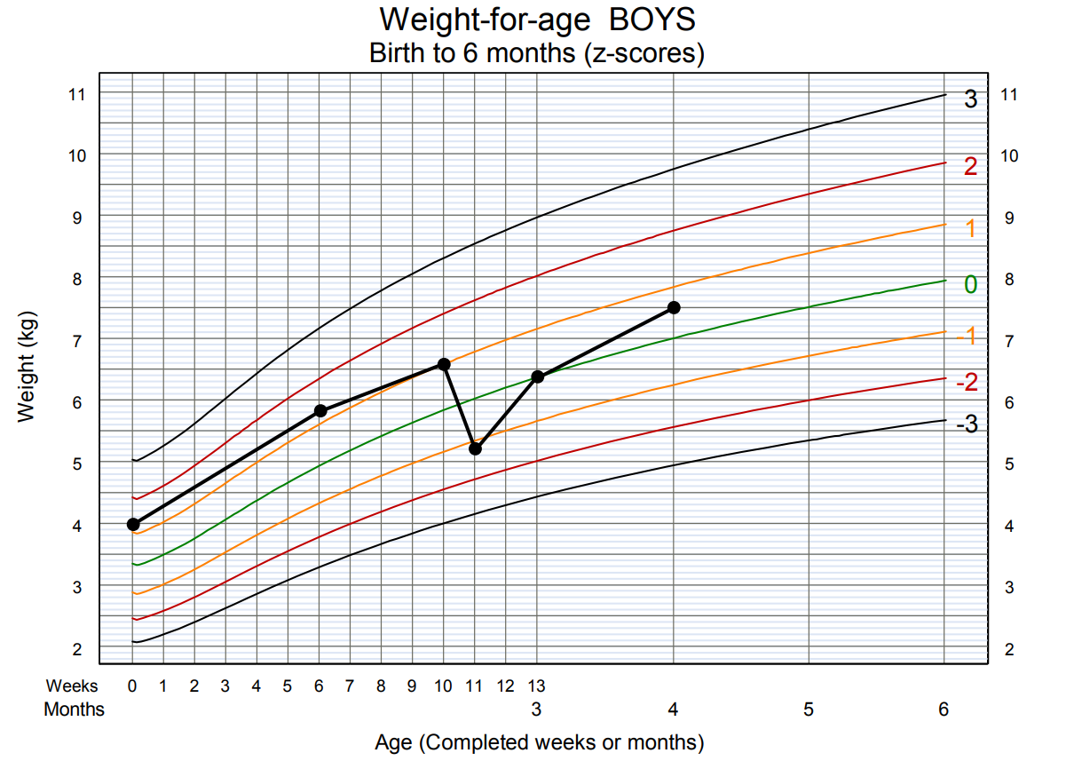
Farhan

Slide 30
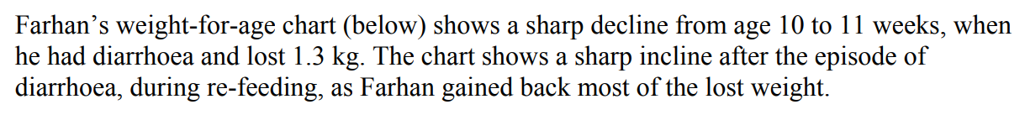

Slide 31
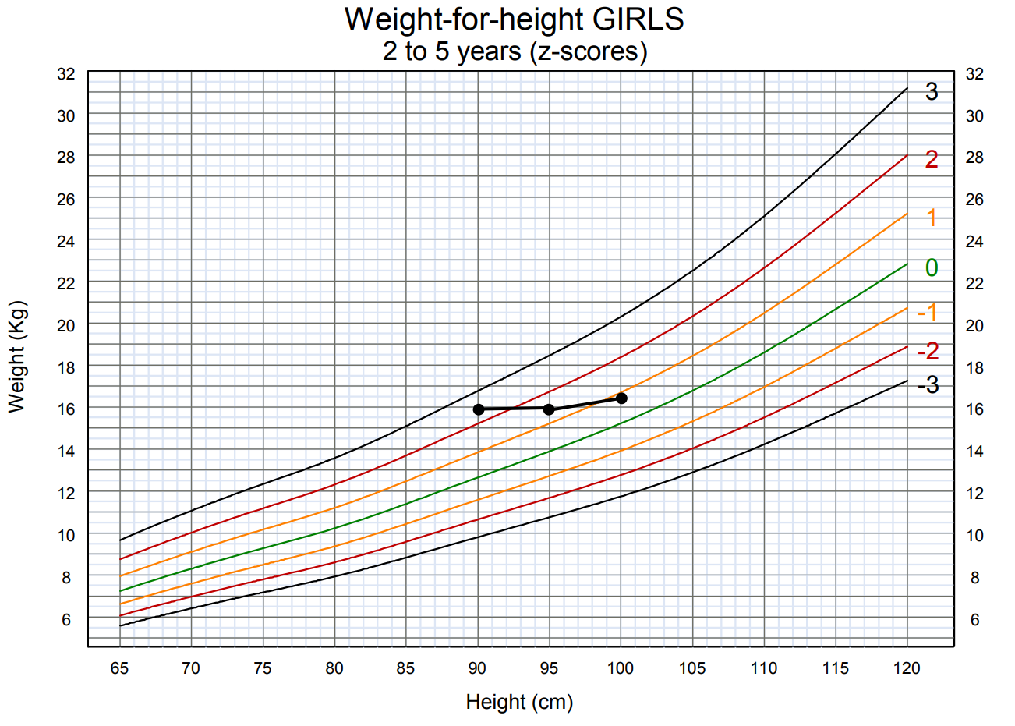
Kadira

Slide 32
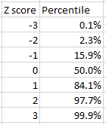
Z-score - Percentile

Slide 33
www.who.int/childgrowth

Slide 34
Thank You

